Slide 1
NATO Terminology Programme
NATO Terminology Office
terminology@nso.nato.int
Brussels, September 2022.

Slide 2
Agenda
Background
Terminology Process

Slide 3
Agenda
Background
Terminology Process

Slide 4

interoperability
The ability to act together coherently, effectively and efficiently to achieve Allied tactical, operational and strategic objectives.

Slide 5
NATO Terminology Programme
Z
Air and Missile Defence
Electronic Warfere
Command & Control
AAP-06
Crisis
Response
Operations
Logistics
Munition
Safety
Intelligence
Training
X
Chemical Warfare
Host Nation Support
Anti Submarine Warfare
Engineers
Standardization
Civil Emergency Planning
Medicine
Combat Service Support
Fire Support
Special Ops
Y

Slide 6
NATOTerm
TermOTAN

Slide 7
……so
NATO standardizes
its terminology!

Slide 8
Documents
PO(2015)0193 NATO Terminology Directive:
Procedures, actors, responsibilities
AAP-77 NATO Terminology Manual
How to write terminology – based on ISO standards

Slide 9
What does this mean?

Slide 10
The same terms and definitions
of the same concepts
in all NATO documents.

Slide 11
How?

Slide 12
Agenda
Background
Terminology Process

Slide 13
Terminology Process
in 4 steps

Slide 14
Terminology process
I. Preparation and Submission
Write your document, using NATO Agreed terminology.
Check the rest of the terminology in your document against the NATO Agreed terminology in database: are there terms/definitions to be added, modified or cancelled? On the basis of this, prepare proposals for addition, modification, cancellation or revalidation.
If so, prepare proposals in accordance with AAP-77 NATO Terminology Manual.
Submit to terminology@nso.nato.int
II. Quality Assurance
NTO checks your proposal and may propose changes.
III. Approval
When you are happy with the substance and NTO is happy with the form, the NTO will submit the terminology to the appropriate committee and request approval.
If approved by consensus, the terminology becomes ‘NATO Agreed’ terminology (compulsory throughout NATO).
IV. Promulgation
NTO updates NATOTerm – this constitutes the promulgation.
NATO Agreed terminology is compulsory throughout NATO.

Slide 15
Terminology
is now
‘NATO Agreed’

Slide 16
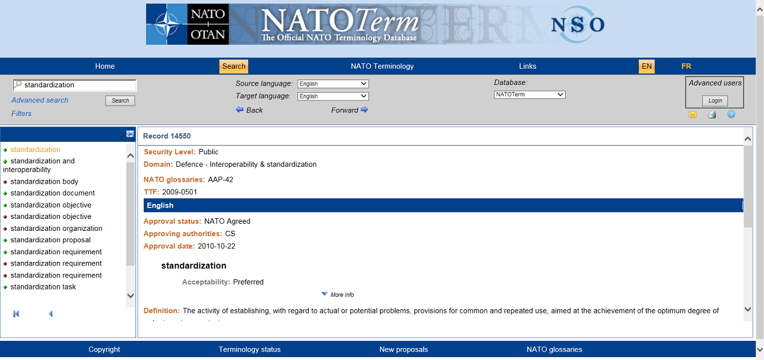
NATOTerm - TermOTAN

Slide 17

NATOTerm enables the terminology from one document to be shared...

Slide 18

... and reused in other NATO documents:

Slide 19
How?

Slide 20
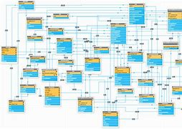
Data referencing

Slide 21
In this way, the terminology for
a given concept
is the same
from one NATO document to another...
...and is thus standardized!

Slide 22
Therefore the ‘NATO Agreed’ meaning is the common meaning, or the common sense.
It is also the official meaning, i.e. the correct meaning, or le bon sens.

Slide 23
NATOTerm. Common sense.
TermOTAN. Le bon sens.

Slide 24
Thank you for your attention!
NATO Terminology Office
terminology@nso.nato.int

